Slide 1
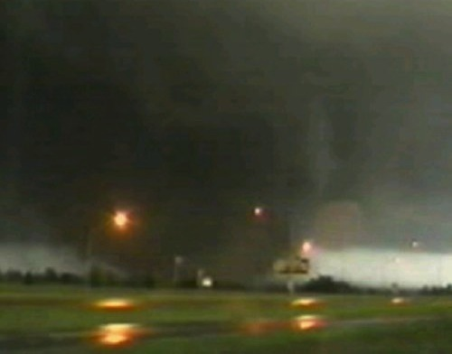
Tornadoes
Charles Stewart MD EMDM MPH

Slide 2
Who am I?
2005 Graduate of EMDM program
2011 Graduate of Tulane School of Public Health MPH program (Disaster Management)
Adjunct Professor of Emergency Medicine
Visiting Professor of EMDM Program
Director, OK Task Force 1, Urban Search and Rescue.
Former Director, Oklahoma Disaster Institute
NASAR Search and Rescue Technician II
DMAT Senior Physician, OK1 DMAT.

Slide 3
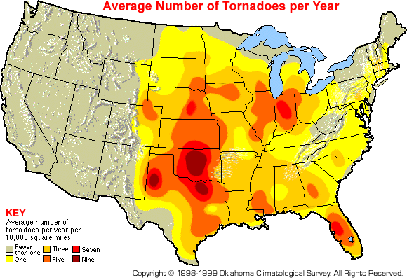
The ‘Battlespace’

Slide 4
The ‘Battlespace’(mod 1)
Researcher Michael Frates identified four areas with high twister activity. The busiest was "Dixie Alley".
Dixie Alley has the highest frequency of long-track F3 to F5 tornadoes
Note that he only looked at F3+
Dixie Alley had a frequency value of 2.92, followed by Tornado Alley (2.59), Hoosier Alley (2.37) and Carolina Alley (2.00).

Slide 5
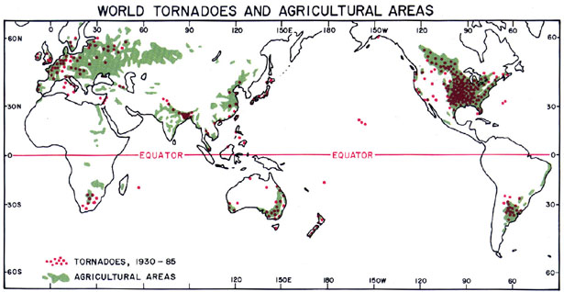
The ‘Battlespace’(mod2)
Other areas of the world that have frequent tornadoes include South Africa, parts of Argentina, Uruguay, and southern Brazil, as well as portions of Europe, Australia and New Zealand, and far eastern Asia.

Slide 6
A Tornado
Tornadoes can come in ‘crops’ within a short period of time
In 1974, US had 148 tornadoes in 2 days.
Tornadoes kill an average of 52 people per year in Bangladesh
This is due to their high population density, poor quality of construction & lack of tornado safety knowledge
UK experiences more tornadoes than any other European country.

Slide 7
Risk Assessment
Overall Risk =
Probability
X
Severity
(Magnitude – Mitigation)

Slide 8
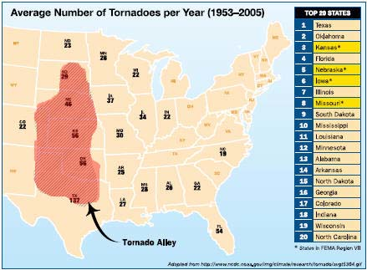
Probability
No matter whether you use the old tornado alley… or the new, OKLAHOMA is number 2 on the hit list from March – June of every year.
The city with the most recorded tornadoes is OKC

Slide 9
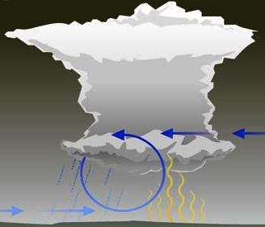
Formation of A Tornado
Gust Front
Formation of a rotating cloud wall – the gust front of a thunderstorm.

Slide 10
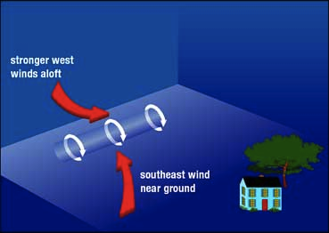
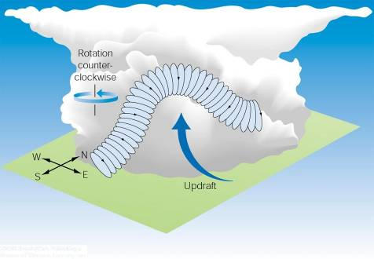
Vorticity from Horizontal to Vertical
Tornadoes usually form in areas where winds at all levels of the atmosphere are not only strong, but also turn with height in a clockwise, or veering, direction. These spinning horizontal vortex tubes created by surface wind shear may be tilted and forced in a vertical path by updrafts.

Slide 11
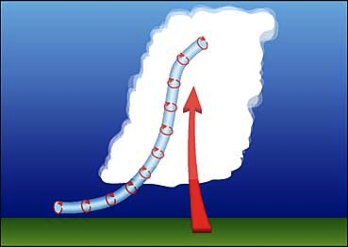
Vorticity from Horizontal to Vertical
This rising, spinning, and often stretching rotating air may then turn into a tornado.

Slide 12
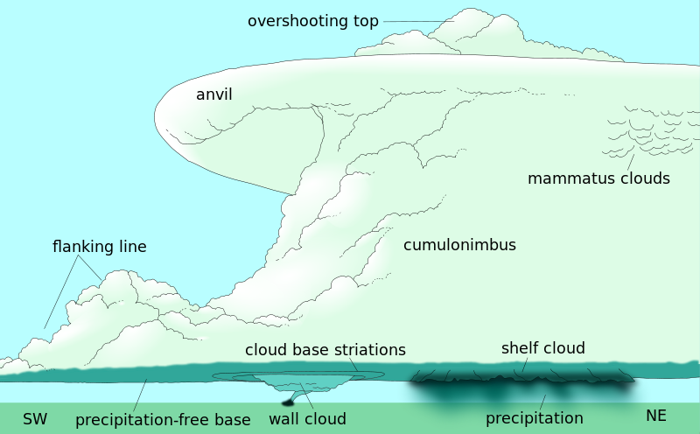
Supercell Tornadoes
Some of the most violent tornadoes develop from supercell thunderstorms. A supercell thunderstorm is a long-lived thunderstorm that has a continuously rotating updraft of air.

Slide 13
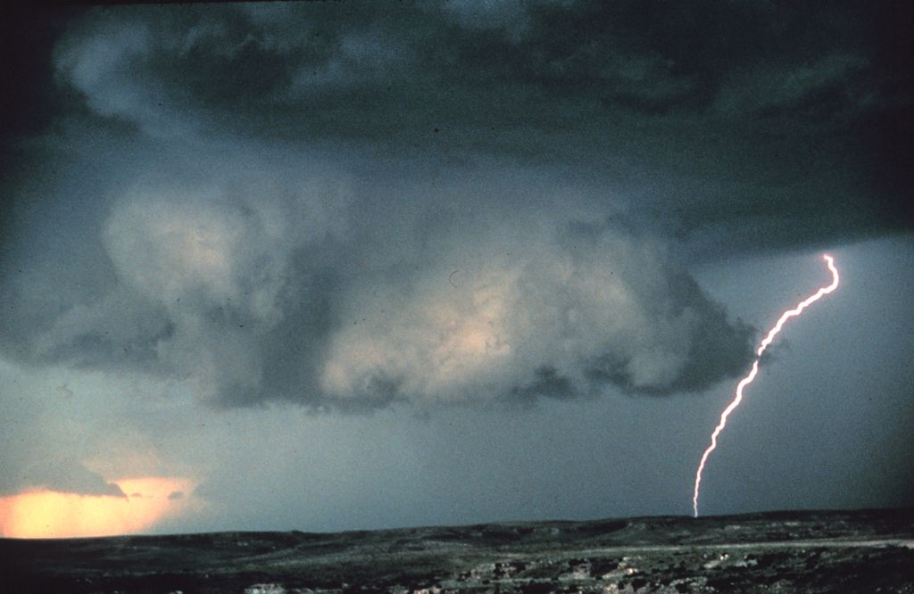
Mesocyclones – A closer look
Mesocyclones are identifiable by a rotating wall cloud like the one in this thunderstorm over Texas.
Some of the most violent tornadoes develop from supercell thunderstorms. A supercell thunderstorm is a long-lived thunderstorm that has a continuously rotating updraft of air.

Slide 14
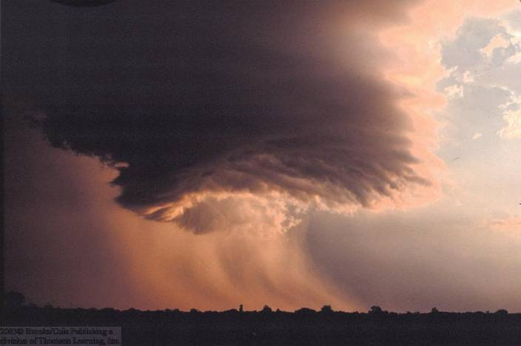
Rotating Clouds
The first sign that a supercell may form a tornado is rotating clouds at the base of the storm, which may lower and form a wall cloud, shown in this picture.

Slide 15
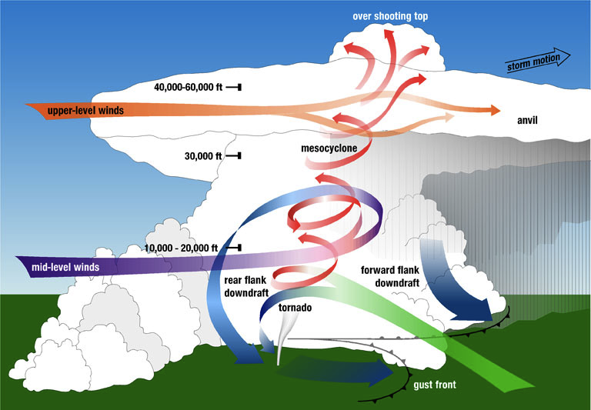
Put it all together…

Slide 16
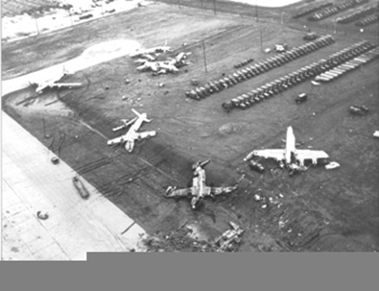
First Tornado Forecast 25 March 1948
Using RADAR, Major Fawbush and Captain Miller determined that the conditions just west of Tinker AFB, OK were suitable for tornado development.
The first tornado forecast was issued that day.
The subsequent tornado caused significant damage to the base.

Slide 17
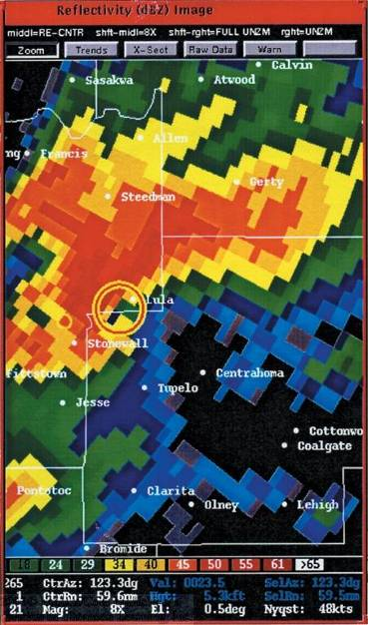
Doppler Radar Analysis
A single Doppler radar unit can uncover many features of thunderstorm rotation and movement, but cannot detect winds parallel to the antenna.
As such, data from two or more units might be combined to provide a complete view of the storm.
Doppler lidar (light beam rather than microwave beam) provides more details on the storm features, and will help measure wind speeds in smaller tornadoes.

Slide 18
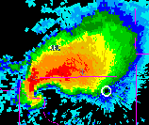
Hook Echo
A “hook echo” is a pattern in radar reflectivity images
Usually in the right-rear part of the storm (relative to the motion of the storm).
A hook is often associated with a mesocyclone and indicates favorable conditions for tornado formation.
The hook is caused by the rear flank downdraft and is the result of precipitation wrapping around the back side of the updraft.

Slide 19
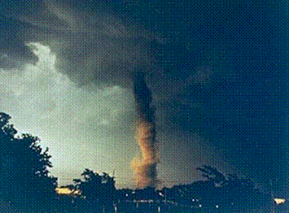
When Tornados Occur
Anytime of the year- usually in the spring, summer, and fall
Most tornados occur during late spring in the month of May
Between the late afternoon and early evening is when most tornados are spawned
The most dangerous time for formation during evening hours
A typical late afternoon tornado

Slide 20
Fujita Tornado Scale
F-Scale Number | Intensity Phrase | Wind Speed
F0 | Gale tornado | 40-72 mph
F1 | Moderate tornado | 73-112 mph
F2 | Significant tornado | 113-157 mph
F3 | Severe tornado | 158-206 mph
F4 | Devastating tornado | 207-260 mph
F5 | Incredible tornado | 261-318 mph
F6 | Inconceivable tornado | 319-379 mph
Fujita scale goes to F12 – Mach 1 winds.
~74%
~25%
~1-2%

Slide 21
F-Scale Converted to EF-Scale
F Scale | Wind Speed | EF-Scale | Wind Speed
F0 | 45-78 | EF0 | 65-85
F1 | 79-117 | EF1 | 86-109
F2 | 118-161 | EF2 | 110-137
F3 | 162-209 | EF3 | 138-167
F4 | 210-261 | EF4 | 168-199
F5 | 262-317 | EF5 | 200-234
Wind speeds in mph, 3-second gust
Notes:
McDonald and Mehta took the regression and applied it to convert the F-scale rating wind speed ranges to the EF-Scale. In this way, there should be continuity in the way we rate the damage. Again, note that the F-scale wind speed ranges you see here are converted from the fastest ¼ mile to a 3 second gust. As a result they are a bit higher than what you may see elsewhere. The 3 second gust is thought to represent how the wind damages structures a little better than the fastest ¼ mile wind speed.

Slide 22
Perspective
Only 2% of U.S. tornadoes reach “violent” intensity, yet those few result in 70% of all tornado deaths.
Their winds exceed 200 mph and they can stay on the ground for an hour or more.
The strongest tornado wind speeds are estimated to be in the 260-318 mph class.
This corresponds to a ranking of F5, the highest on the Fujita tornado scale.
During the last decade, less than a dozen twisters were estimated to reach this kinetic milestone.
Moore 1999 and 2013 were among the most violent of them all.

Slide 23
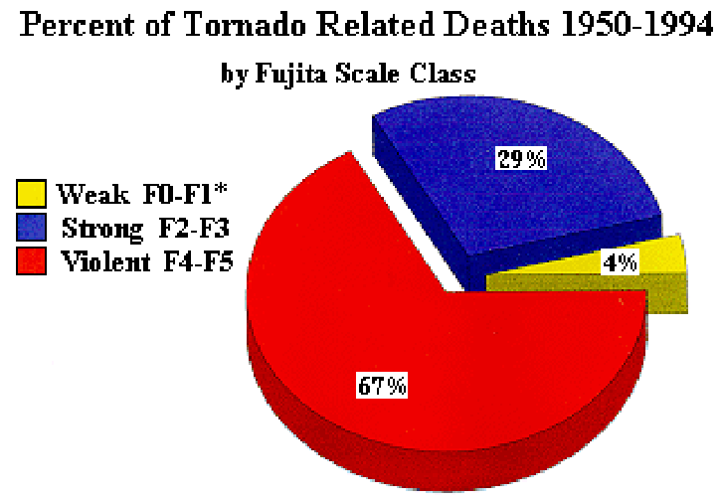
Tornado Deaths by Category

Slide 24
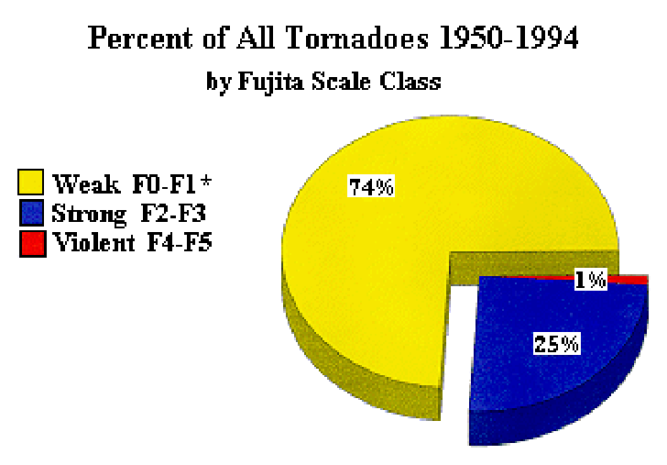
Tornado Occurrence by Category

Slide 25
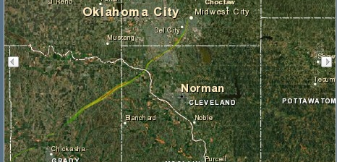
Path of the Moore Tornado 1999 F5

Slide 26
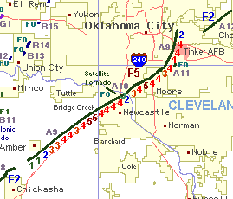
Path of the Moore Tornado 1999

Slide 27
Moore Tornado 1999
F5 Tornado
Estimated Damages $1 Billion US
Time: 1 hour 25 minutes
36 Deaths
583 Injuries

Slide 28
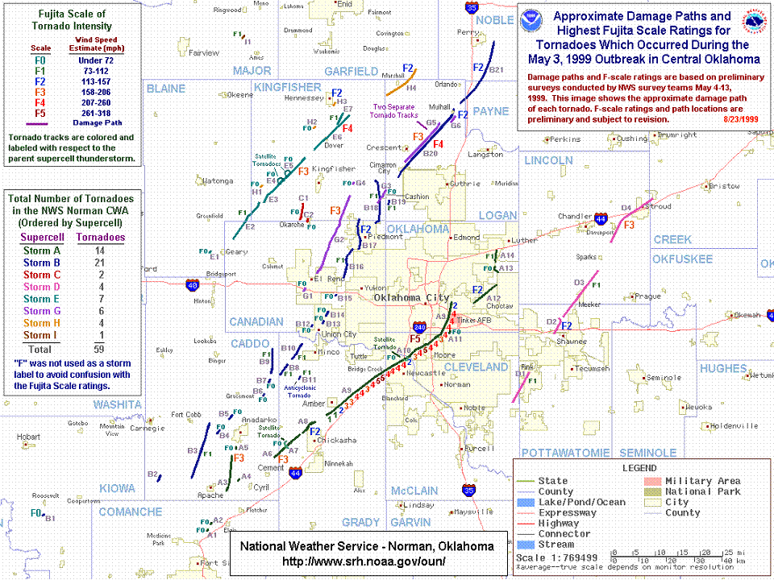

Slide 29
Magnitude Moore, 1999 F5 Tornado
Facts about the storm
Time on the ground | Over three hours
Length of track | Over 80 miles
Track width | ¼ to 1 mile wide
Lives lost | 44
Injured (treated) | 795
Homes Destroyed | 2,076
Homes Damaged | 6,550
Apartment Units destroyed | 473
Businesses Destroyed | 85
Schools and Churches Destroyed | 5

Slide 30
DEATHS
45 persons died
3 cardiac deaths (not injured)
1 preparing for the tornado
Disabled and dropped while being carried to shelter
1 after the tornado
Did not evacuate, gas leak, lit candles.
40 directly from tornado
Notes:
45 persons died as a result of the tornado
3 persons were not injured but died of cardiac conditions
One disabled person was fatally injured prior to the tornado when he was dropped while being taken down a flight of stairs in his wheelchair to the basement for protection.
One person refused to leave their damaged residence. Several candles had been lit for lighting and apparently a gas leak caused a fire and the person died from smoke inhalation and burns.
40 persons were fatally injured in the tornado

Slide 31
INJURIES
577 injured persons
26 preparing for the tornado
Often running for shelter
39 after the tornado
Mostly clean-up injuries
512 directly from tornado
Notes:
577 persons were treated in hospitals for tornado-related injuries
26 persons were injured preparing for the tornado. Injuries preparing for the tornado occurred when persons fell down stairs going to a storm shelter or basement; or the door of the storm shelter hit their head, foot, or finger; or falling or running into something while running to seek shelter. Most of these injuries were minor.
39 persons were injured after the tornado during clean-up, or trying to get into or out of damaged areas. Common injuries were puncture wounds from stepping on a nail, and muscle strains from lifting heavy objects. Two persons were admitted to a hospital as a result of a MVC.

Slide 32
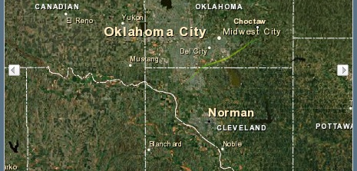
Path of the Moore Tornado 2003 F4

Slide 33
Moore Tornado 2003
F4 Tornado
Estimated Damages $160 Million US
0 Deaths
89 Injuries

Slide 34
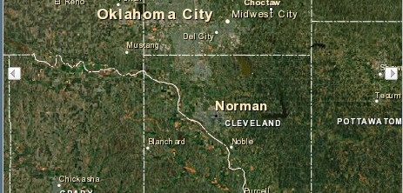
Path of the Moore Tornado 2013 F5

Slide 35
Moore Tornado 2013
F5 Tornado
Estimated Damages $3 Billion US
Time: 50minutes
24 Deaths
237 Injuries
16 minutes warning time

Slide 36
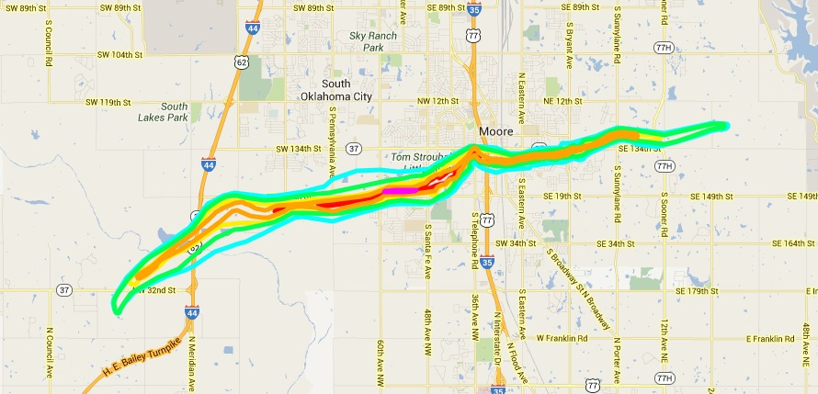
Path of the Moore Tornado 2013 F5

Slide 37
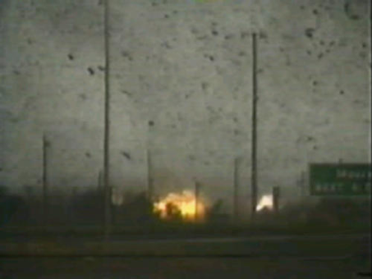
Mechanism of Injury 1
Tornado, crossing through Moore, OK. The debris seen in the picture is being propelled at speeds over 300mph.
The injurious effect of such debris can be likened unto that of artillery shell fragments.
Contrary to popular opinion, often more serious injuries result from being struck by these fragments than from being trapped beneath rubble

Slide 38
Most Common Types of Injury
Soft tissue injuries
Includes lacerations, abrasions, and contusions of the soft tissues
Fractures/dislocations
Brain injuries
Foreign bodies

Slide 39
PROBABLE CAUSE OF DEATH
Multiple injuries (50%)
Head injuries (23%)
Do you recommend a helmet, doctor?
Chest trauma (18%)
Traumatic asphyxia (10%)

Slide 40
SPECIFIC LOCATIONS OF 27 PERSONS WHO DIED
19 (70%) not in recommended place
8 mobile home
7 outdoors (2 under overpass)
1 upstairs apartment
2 rooms with exterior walls
1 motor vehicle (under overpass)
8 (30%) in recommended place
5 closet
3 bathroom

Slide 41
Lessons Learned
When a large violent tornado intersects a metropolitan area, people will die!
The 1999 Moore tornado had PLENTY of advance warning.
Some died even when they did the ‘right’ thing.
There is no guaranteed ‘safe place.’
It’s a probability game… and the stakes are your life.
Evacuation is NOT an option.

Slide 42
Lessons Learned
Overpasses are death traps. – AVOID THEM!
3 deaths that day directly because of overpass ‘sheltering.’
Neighbors WILL help Neighbors.
Disaster managers need to realize this.
CERT training augments this

Slide 43
Lessons Learned
Head Trauma Kills – WEAR a Helmet!
23% of deaths because of head trauma.
It took us 10 years to process that and to start advocating helmets for all
No added risks from a helmet
We haven’t yet quantified benefit
CDC ‘poo-poo’d us’ for 10 years.
Now ‘reluctantly’ advocates helmets

Slide 44
Lessons Learned
Forecasters earned their pay 3 May 1999…
Upgraded the forecast every 30 minutes.
And… They thought ‘out-of-the-box’
They issued a “TORNADO EMERGENCY” warning.
TAKE COVER IMMEDIATELY or you will DIE.
There isn’t any such warning in the book… They did it anyway.

Slide 45
Lessons Learned
EMSA paid very close attention to the weather and vectored ambulances to the side of the tornado’s path.
Some were even on calls at the time!
Alternative transport was widely used.
EMSA ambulances stayed at scene and became ‘mobile clinics’

Slide 46
PROTECTION
The best protection is a storm shelter
Go to lowest level of dwelling, away from exterior walls, in an interior closet or bathroom
Need to examine how public perceives “recommended safe place”
Cover the body with thick blankets or clothing (protect from flying debris)
Protect the head from brain injury by wearing a motorcycle or bicycle helmet

Slide 47
RECOMMENDATIONS
Have a preparedness plan in advance
If in a mobile home, LEAVE immediately. Have a predetermined shelter
Heed the warnings
Increase availability of shelters
This led to a FEMA program for ‘safe rooms.’
Increase knowledge of location of shelters
This led to a FEMA program for community shelters.

Slide 48
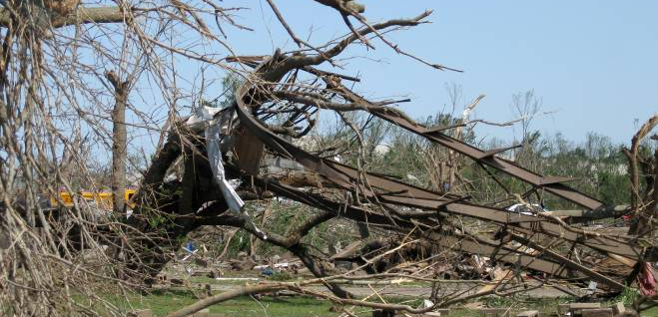
Mobile Home Frame Wrapped Around Tree

Slide 49
RECOMMENDATIONS
Don’t seek protection under overpasses
If caught outdoors or in motor vehicle, seek substantial shelter
Wear a helmet!

Slide 50
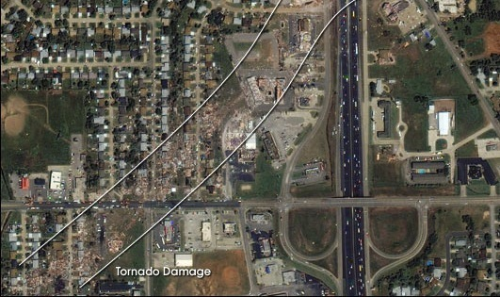
Probability…. Moore 2003 redux

Slide 51
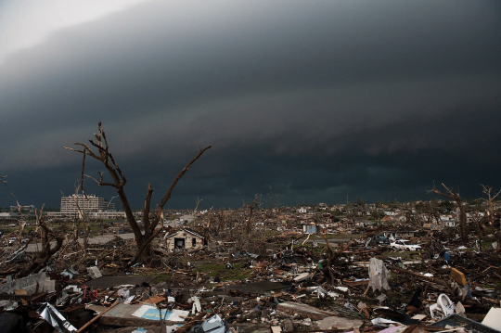
Probability…. Joplin 2011

Slide 52

May 22, 2011
Typical Sunday
Family Gatherings Lunch/Dinner
Shopping
Joplin High School Graduation

Slide 53
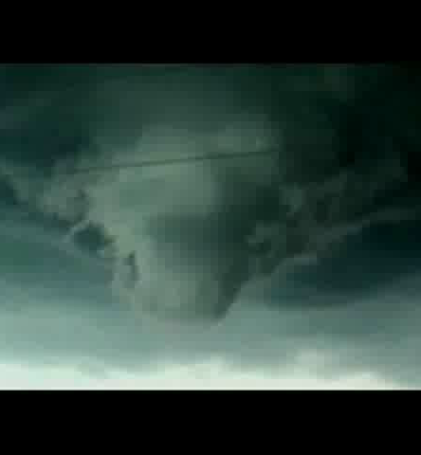
Area Tornado Warning Issued
5:13pm
In The Next 28 Minutes The Medical Landscape of Joplin Will Literally and Figuratively Change …..…Forever

Slide 54
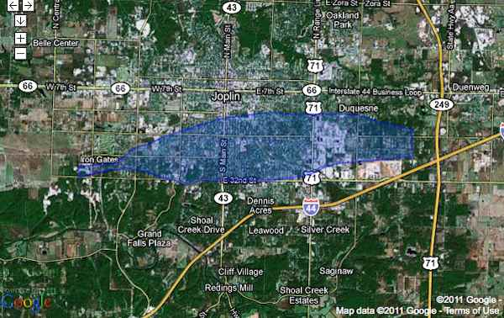

Tornado On The Ground
SJ
FREEMAN

Slide 55
Joplin Tornado
The EF-5 Joplin tornado had winds in excess of 200 mph, was 3⁄4 of a mile wide, and had a track lasting six miles.
The Joplin tornado is the deadliest single tornado since modern recordkeeping began in 1950 and is ranked as the 7th deadliest in U.S. history.
There were 157 fatalities from the Joplin tornado.

Slide 56
Initial Impact
Medical Facility Operating On Alternate Power
Loss of External Landline Communication
Compromised Internal Communication
Loss Of Water Pressure
Computer Systems Inoperable
Magnitude Yet Unknown

Slide 57
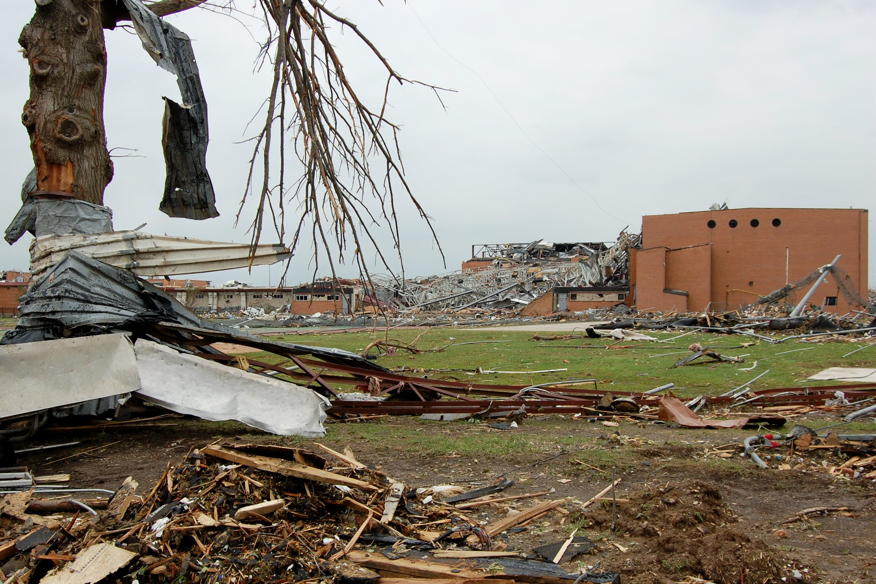
EMS Response
Destruction Wide Spread
Schools,
Business,
Medical facilities
Residential areas
Destruction Wide
Spread – Schools,
Business, Medical
And Residential
Impacted

Slide 58
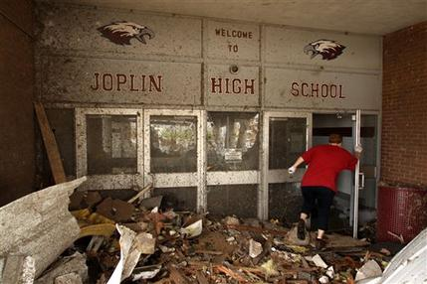

Slide 59
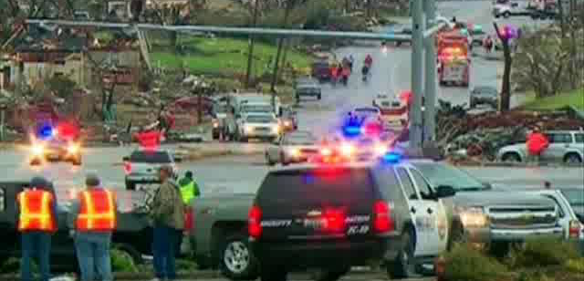
EMS Response

Slide 60
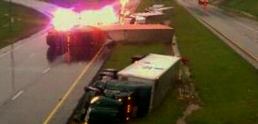
Magnitude Incomprehensible

Slide 61
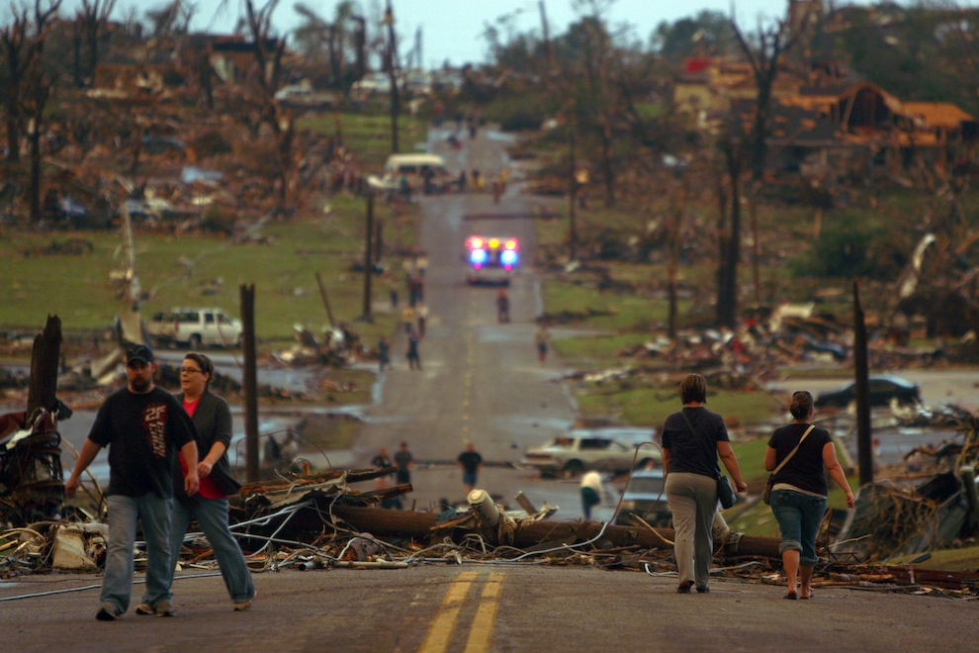

Slide 62
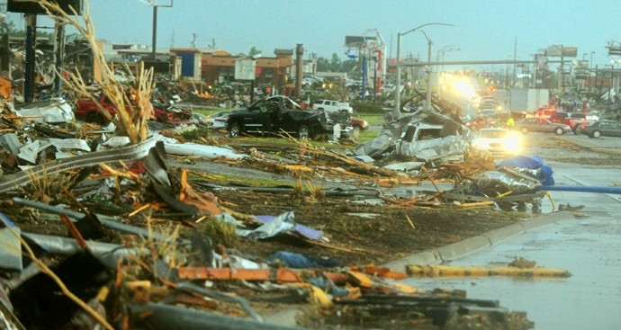

Slide 63
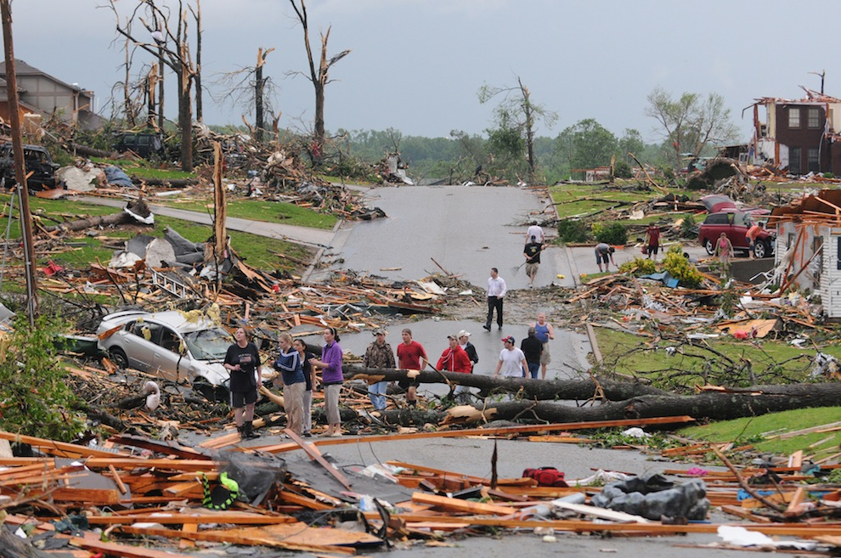

Slide 64
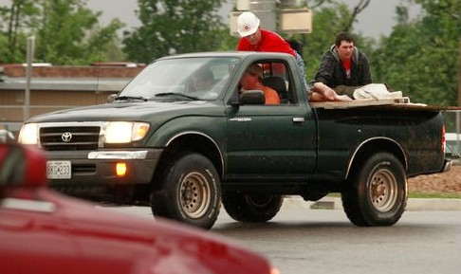

Slide 65
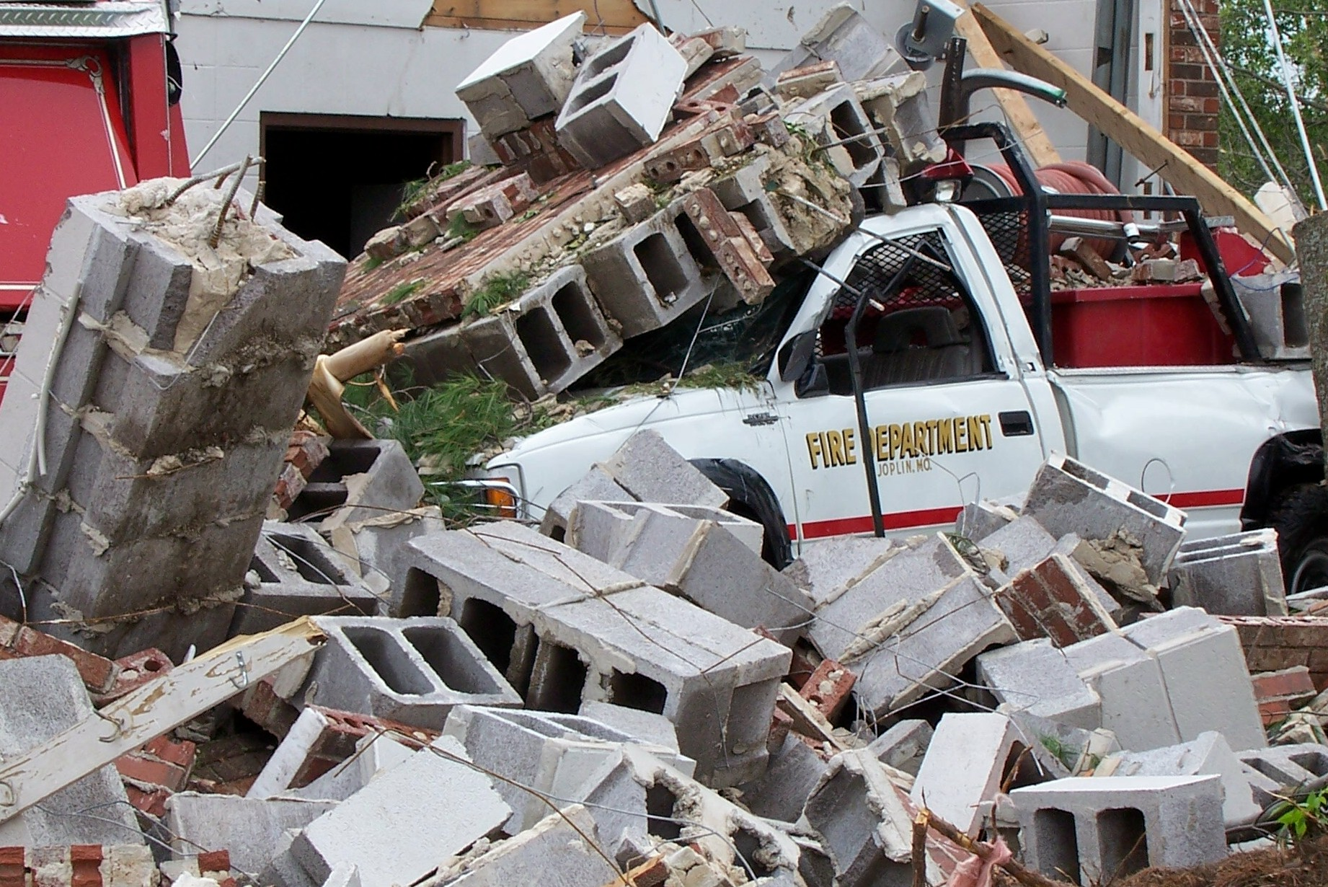

Slide 66
ED Response/Activity
Discharge Current Minor Ill and Injured Patients
Movement of Patients From Halls Into ED Rooms
Supplies/Equipment Prepositioned
Transferring/Stabilizing As Possible

Slide 67
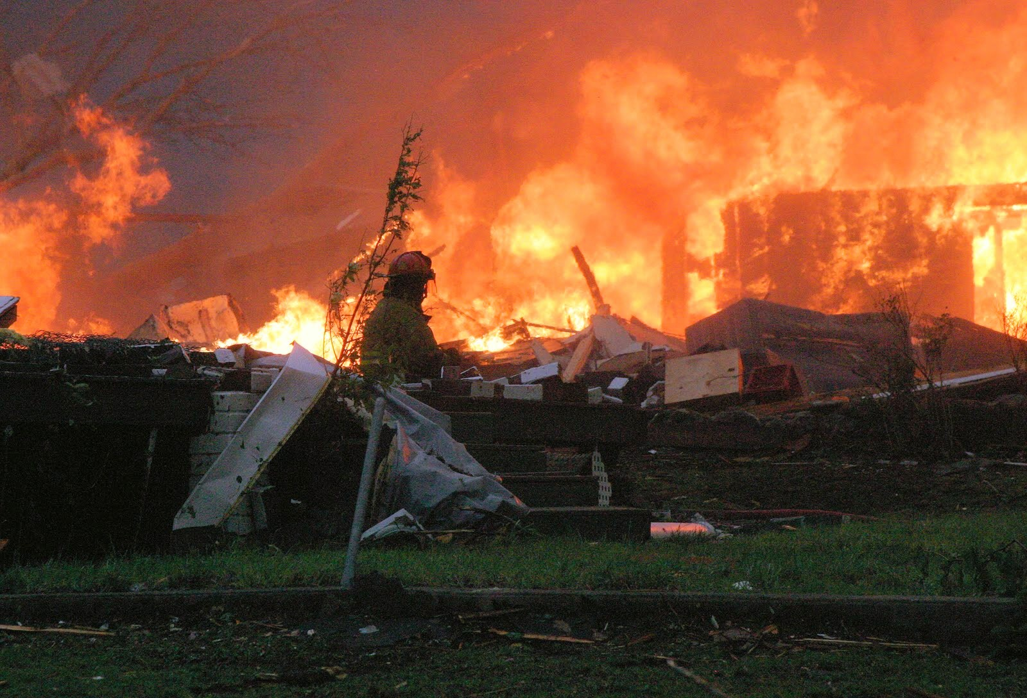
Emergency Response Systems Inundated With Calls for Help

Slide 68
Emergency Response Systems
Are compromised

Slide 69
Emergent Response
In The Next Hours Over 1,000 Patients Are Treated in the ED and Alternate Care Sites
Cath Lab, CVOR, OR All Occupied
22 Life Saving Surgeries Performed In First 12 Hours
Over 800 Xray Procedures/Approx 400 CT Scans

Slide 70
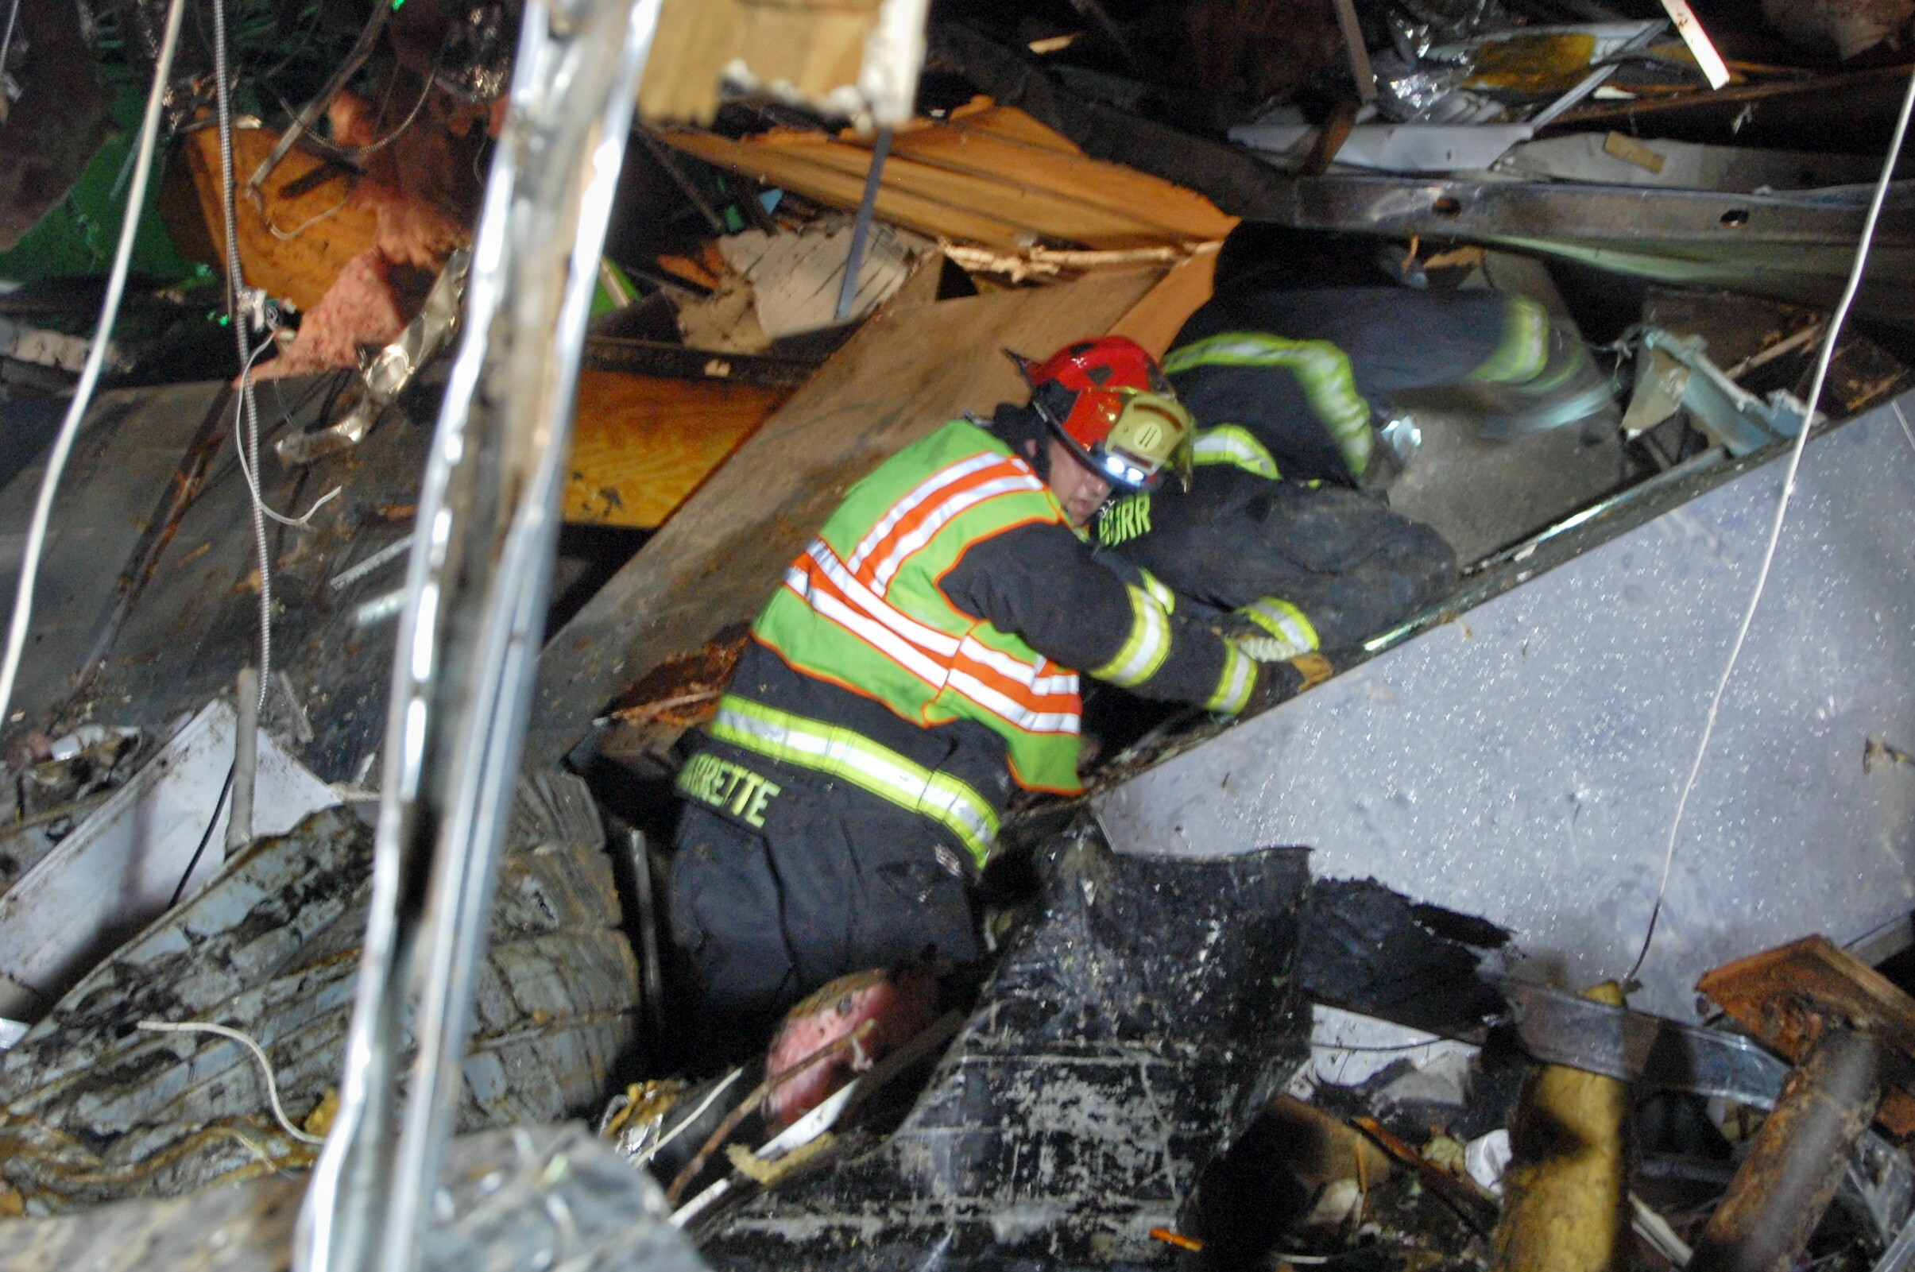
OK-TF1 responds

Slide 71
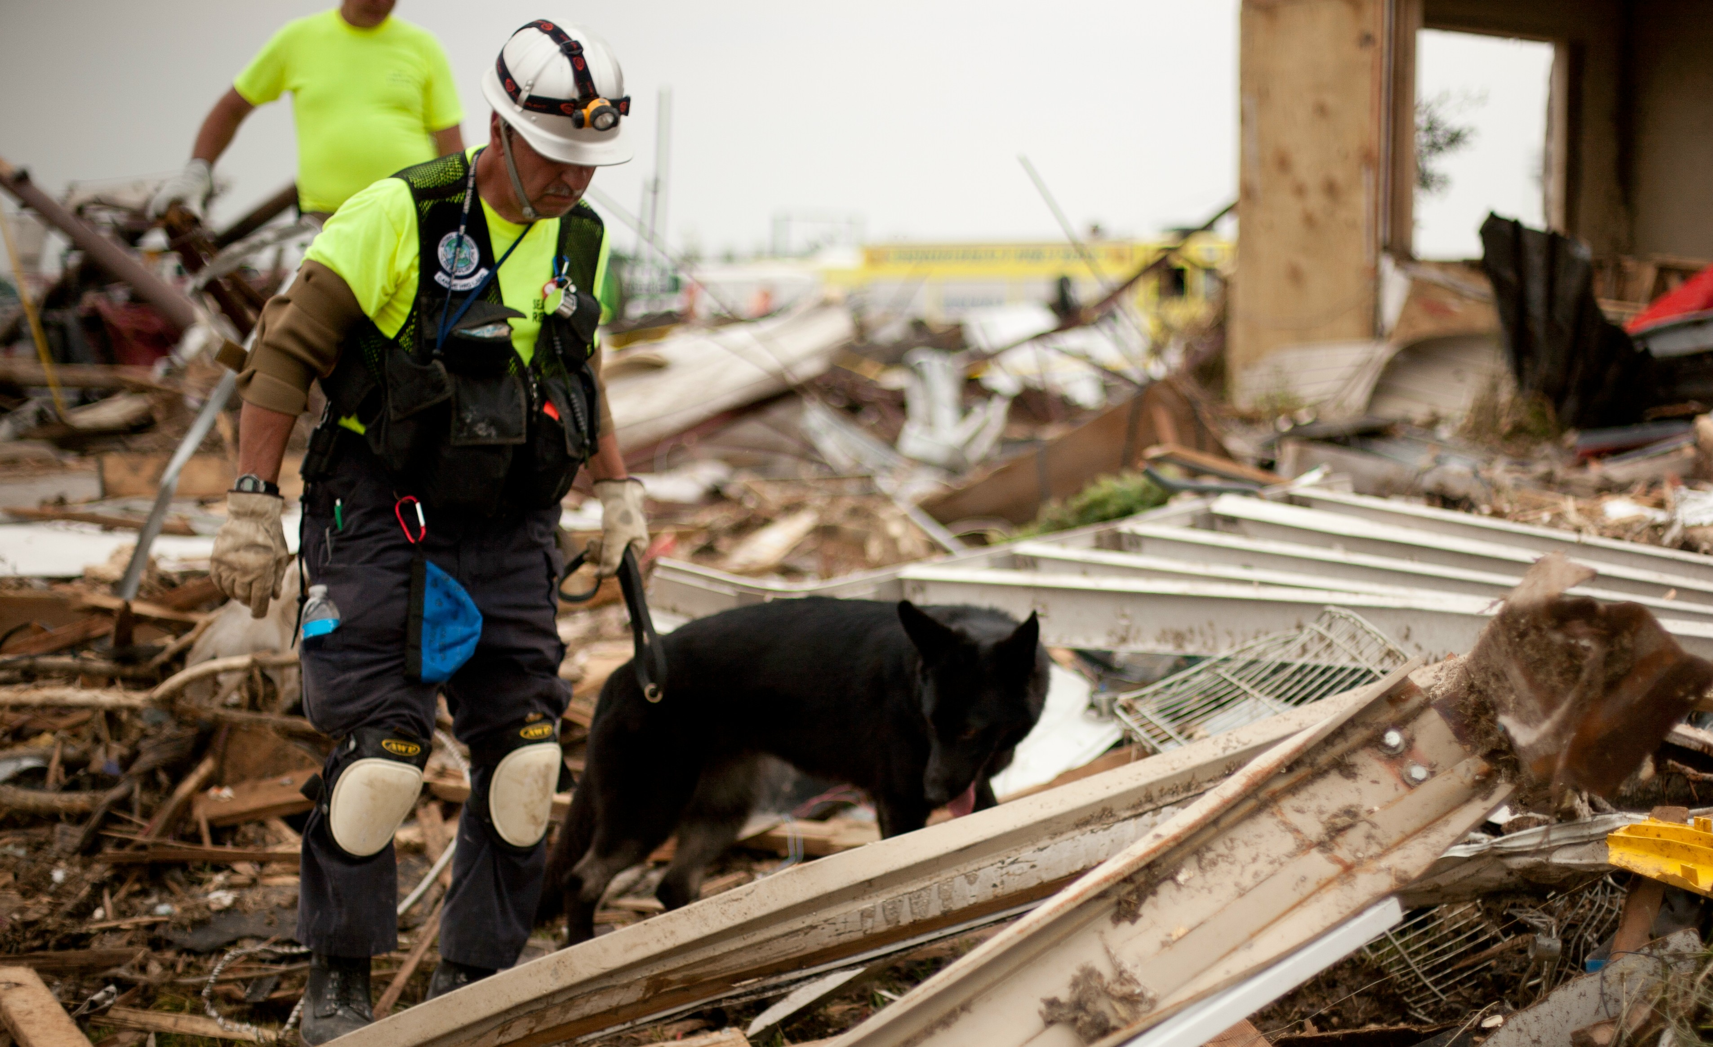

Slide 72

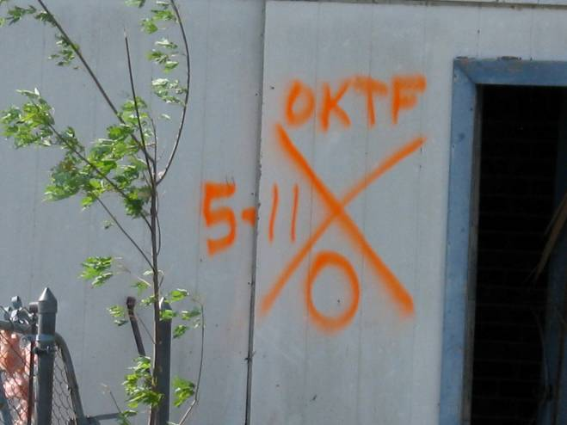

Slide 73
Lessons Learned
System Processes Must Be Easily Converted to Manual Processes
Adaptable Disaster Patient ID/Triage
PAR Level – Supplies/Procedures – Stock more than 3 days in supplies
Orthopedic Supplies
Lighting – Hand Free is essential
Increased Quantity Radios (and batteries)

Slide 74
Lessons Learned
Staffing Assignments – Nurse to Physician
Wallet ID Cards For Staff or Maintain ID Badge In Vehicle
Pyxis Access Override (Key)
Fire axe also works to open the Pyxis…
Transfer Patients Lesser Severity To Other Care Areas or Other Hospitals/Care Centers
Practice….Practice….Practice

Slide 75
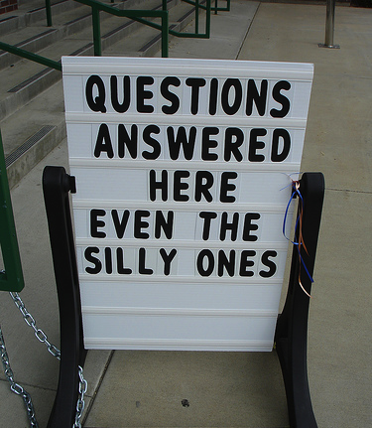
Thank you!
Chuck Stewart MD EMDM MPH

